Slide 1

Comprehensive Digital Marketing for Wipro

Slide 2

Project Name: Wipro
Team Leader:
Budida.Padmavathi
Team members:
1)Bayi.Bhumika
2)Bendi.Rama
3)Bikkavolu.Jeevitha
4)Chokkakula.LavanyaKumari

Slide 3
Introduction:
Wipro is a super cool company based in India that specializes in information technology services. They offer a bunch of awesome stuff like IT consulting, software development, and business process outsourcing
They work with different industries like healthcare, banking, retail, and manufacturing. Wipro is known for being innovative and using technology to solve problems. They’re like a trusted friend for businesses all over the world!
Wipro is the leading strategic IT partner for companies across India, the Middle East and Asia–Pacific – offering integrated IT solutions. They plan, deploy, sustain and maintain your IT lifecycle through their total outsourcing, consulting services, business solutions and professional services

Slide 4
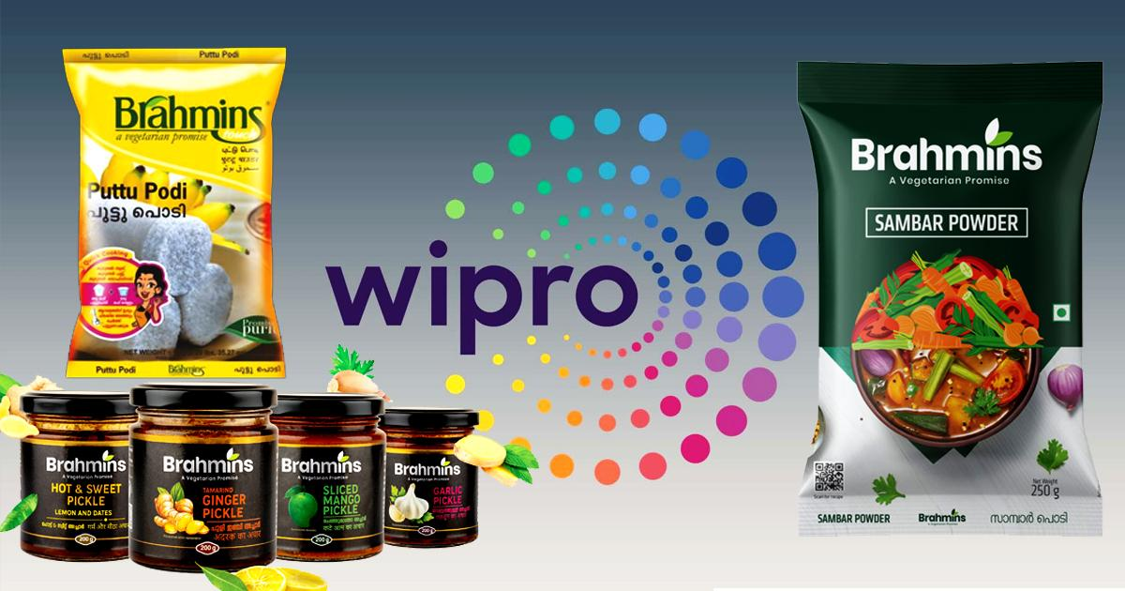

Slide 5

Research Brand:Wipro
Mission/Values:Our core values – The Spirit of Wipro, best reflect what we do and believe in: Be passionate with client’s success. Treat each person with respect. Be global and responsible. Unyielding integrity in everything we do.

Slide 6

Unique Selling Proposition (USP):
The unique selling proposition of Wipro is its ability to deliver innovative and customized solutions to meet clients’ specific needs. They focus on technology-driven transformation and have a strong global presence.

Slide 7
Analyse Brand tone and Identity:
Wipro’s brand tone and identity can be described as professional, innovative, and reliable.
They have a strong presence in the IT industry and are known for their expertise and cutting-edge solutions.
Wipro’s brand reflects a sense of trust and credibility, positioning them as a reliable partner for businesses.

Slide 8
Smart Goals of wipro :
1. Increase market share by launching innovative and competitive products. 2. Improve customer satisfaction by enhancing product quality and support. 3. Enhance operational efficiency by implementing process improvements and automation. 4. Expand into new markets or geographical regions to increase revenue. 5. Foster a culture of innovation by encouraging employee creativity and collaboration.

Slide 9

Key Performance Indicators:

Slide 10
Key Performance Indicators (KPIs):
1. Revenue growth: Tracking the company’s financial performance and growth over time. 2. Customer satisfaction: Measuring customer feedback and satisfaction levels with products and services. 3. Product quality: Monitoring the number of defects or issues reported and resolved. 4. Time to market: Measuring the speed and efficiency of product development and launch. 5. Market share: Tracking the company’s share of the market compared to competitors.

Slide 11
Buyer’s Audience Persona:
Wipro Limited is also known as Western Indian Products Limited which is a global service provider delivering information technology and business services. It was founded by Mohamed Premji in 1945. The company’s headquarters are located in Bangalore, India. Wipro’s buyer’s audience persona includes IT professionals, business leaders, and decision-makers in various industries. They value innovation, quality, and reliable technology solutions. Wipro focuses on understanding their needs and providing tailored solutions to meet their specific requirements.

Slide 12
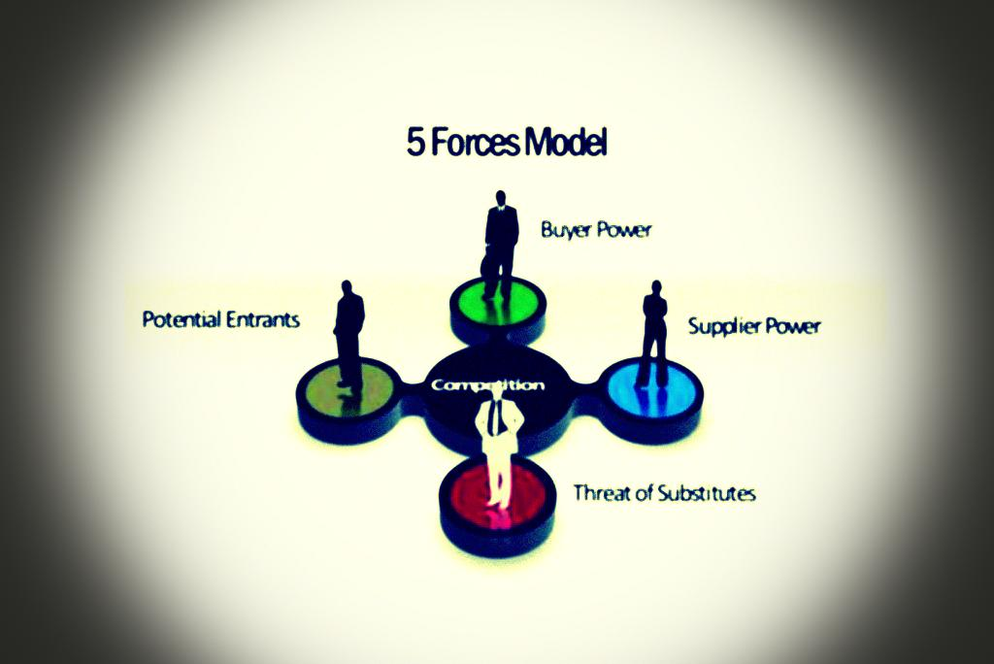
Forces models:

Slide 13
Competitor Analysis:
Wipro faces competition from several major players in the IT industry, including TCS and Infosys.
These competitors offer similar services and solutions, and each has its own strengths and weaknesses.
Wipro’s key strengths lie in its global presence, diverse portfolio of services, and strong customer relationships.

Slide 14
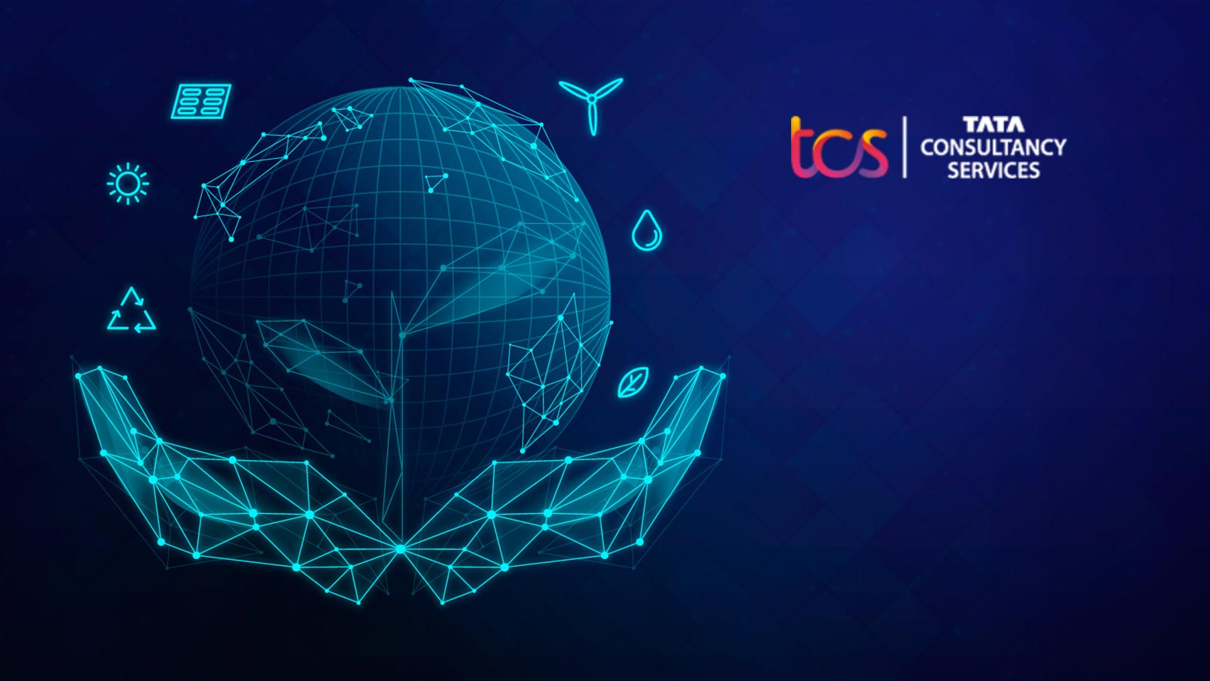
Competitor 1-TCS

Slide 15
Competitor 1:
TCS, which stands for Tata Consultancy Services, is one of the biggest competitors of Wipro. They offer similar IT services and solutions, and both companies are known for their expertise in the industry. TCS, one of Wipro’s major competitors, has its own strengths, weaknesses, opportunities, and threats. Some of TCS’s strengths include its strong global presence, diverse service offerings, and a large pool of talented professionals.
However, they also face weaknesses such as potential dependency on a few key clients.

Slide 16

Competitor 2-INFOSYS

Slide 17

Competitor 2:
Another major competitor of Wipro is Infosys. Just like Wipro, Infosys is a global IT services and consulting company based in India.
They offer a wide range of services including software development, system integration, and IT consulting.
Infosys has a strong reputation for delivering high-quality solutions to their clients.
They have a global presence and a large workforce of skilled professionals.

Slide 18

Competitor 3 -HCL
Technologies is one of Wipro’s competitors. They are also a well-known IT services company in India. HCL Technologies is a strong competitor of Wipro.
Both Wipro and HCL Technologies compete in the same market, striving to provide innovative solutions to their clients.

Slide 19
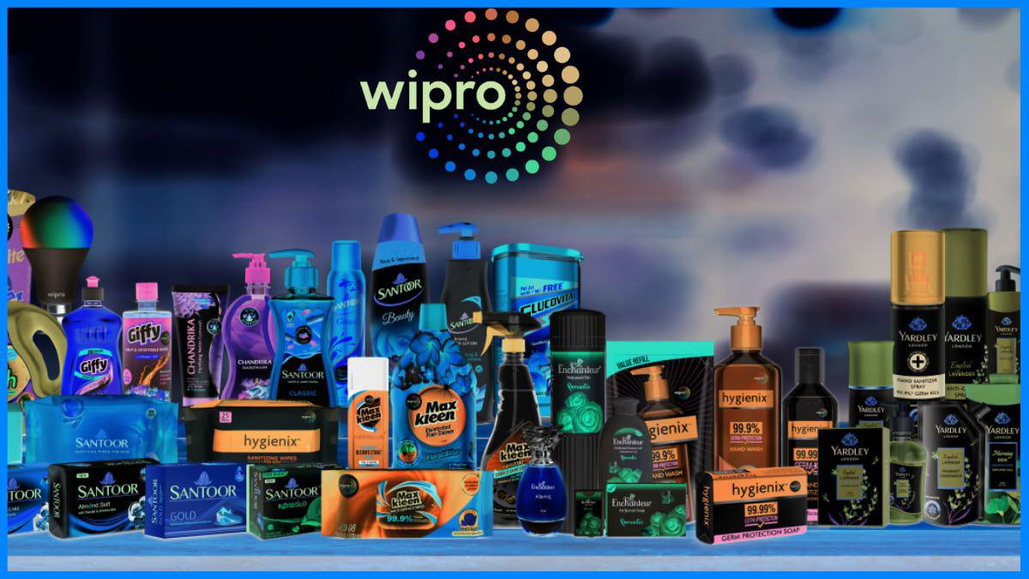

Slide 20
SearCh Engine Optimization Audit(SEO):
Keyword Research: In this phase, we would conduct thorough research to identify relevant keywords that users are searching for in relation to Wipro’s services. This helps optimize website content and meta tags to improve search engine ranking.
On-Page Optimization: Under this heading, we would focus on optimizing individual web pages of Wipro’s website. This includes incorporating target keywords in page titles, headings, URL structures, and meta descriptions.
Technical SEO: This aspect deals with ensuring that Wipro’s website is technically optimized for search engines. It involves factors like website speed, mobile-friendliness, crawlability, and indexability.
Backlink Analysis: In this stage, we would analyze the quality and quantity of websites that link back to Wipro’s site.
Content Strategy: Under this heading, we would develop a comprehensive content plan that aligns with Wipro’s target audience and industry trending. This includes creating informative and engaging content that attracts organic traffic and encourages social sharing.

Slide 21
Keyword Research:
“Wipro services” – This keyword highlights the range of services provided by Wipro. “Wipro IT consulting” – This keyword focuses on Wipro’s expertise in IT consulting. “Wipro software development” – This keyword emphasizes Wipro’s capabilities in software development. “Wipro digital transformation” – This keyword highlights Wipro’s role in helping businesses with digital transformation initiatives. “Wipro global presence” – This keyword showcases Wipro’s global reach and presence.

Slide 22
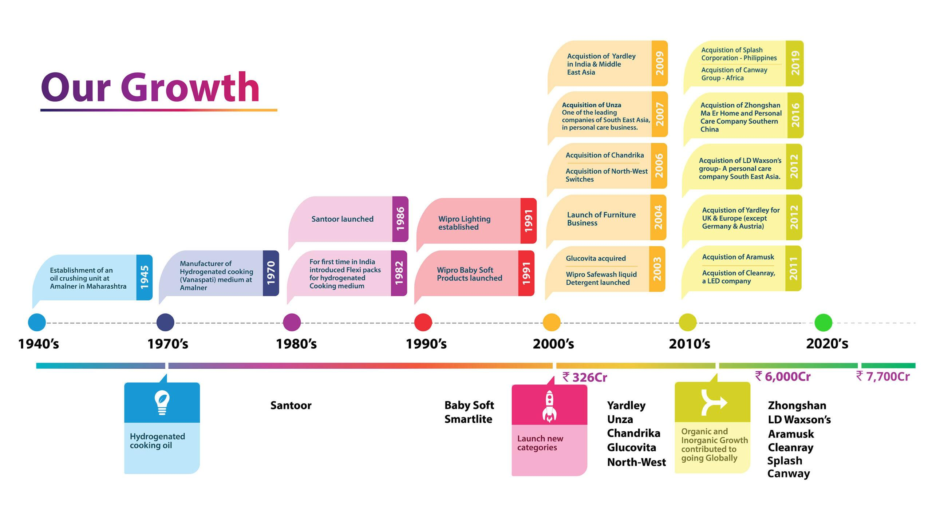
Content Ideas And Marketing Strategies:

Slide 23

Content Idea Generation And Strategy:
1. Explainer Videos: Create short videos that explain complex technology concepts in a simple and engaging manner. This can help educate the audience and showcase Wipro’s expertise. 2. Infographics: Design visually appealing infographics that highlight industry trends, statistics, and Wipro’s solutions. These can be easily shared on social media and websites to attract attention. 3. Blog Series:. Develop a series of blog posts that delve into specific industry topics, providing insights, tips, and best practices. This can position Wipro as a trusted source of information and drive organic traffic to their website.

Slide 24
Marketing Strategies:
Identify target audience segments and tailor content to their specific needs and pain points. Utilize social media platforms to share content, engage with the audience, and build a community around Wipro’s brand. Collaborate with industry influencers or experts to co-create content and expand reach. Leverage email marketing campaigns to nurture leads and stay connected with existing clients. Measure and analyze the performance of content using metrics such as engagement, conversions, and website traffic to refine the strategy over time. It’s essential for Wipro to align their content ideas and marketing strategy with their business goals, target audience, and industry trends. Regularly reviewing and adapting the strategy based on data and feedback will help ensure its effectiveness.

Slide 25
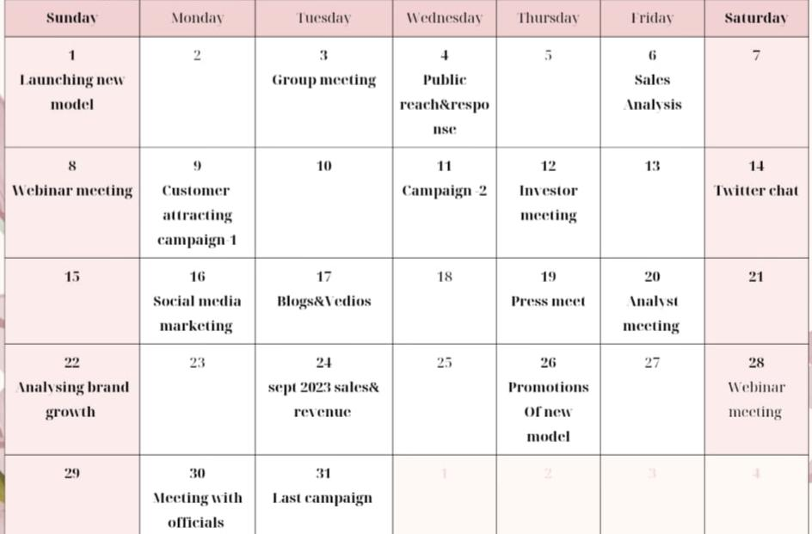
Wipro-Monthly Calender:

Slide 26
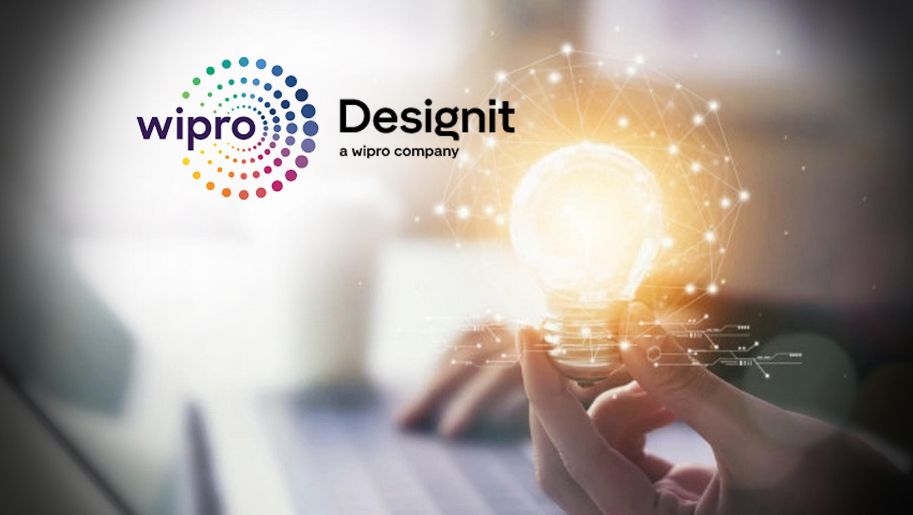

Slide 27
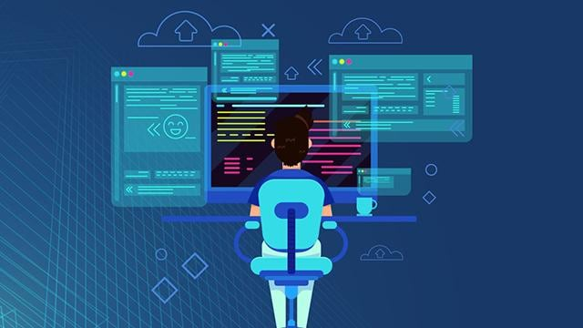

Wipro-Social Media marketing:

Slide 28

Social Media Marketing:
Wipro can use various social media marketing strategies to enhance its online presence and engage with its target audience. Here are a few ideas: 1. Content Sharing: Wipro can regularly share informative and engaging content, such as blog posts, videos, and infographics, on social media platforms like LinkedIn, Twitter, and Facebook. This can help establish Wipro as a thought leader in the industry and drive traffic to their website. 2. Community Engagement: Actively participate in relevant industry groups and forums on platforms like LinkedIn and Reddit. Wipro can share insights, answer questions, and contribute to discussions, showcasing their expertise and building relationships with potential clients.

Slide 29
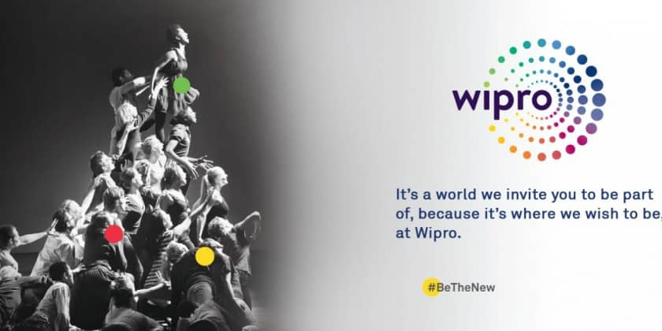
Wipro-Instagram Marketing:
Wipro has a strong presence on Instagram, where they showcase their corporate culture, employee stories, and innovative projects. They also share updates on their services and solutions, providing insights into their expertise. It’s a great platform to stay connected with Wipro and get a glimpse into their world.

Slide 30
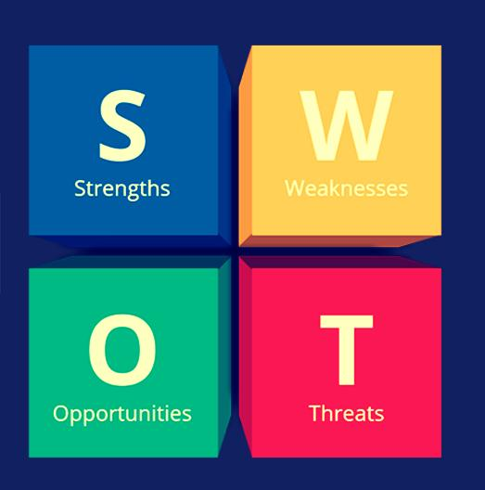

Slide 31
Swot analysis:
Strengths: Global Presence: Wipro has a significant global footprint with operations in numerous countries, providing access to diverse markets and a large talent pool
Weakness:Competitive Market: The IT industry is highly competitive, with multiple global and local players, leading to price pressures and competition for talent. Employee Attrition: High employee attrition rates can pose challenges in retaining and nurturing talent.
Opportunities:Digital Transformation Demand: The growing demand for digital transformation services presents opportunities for Wipro to expand its capabilities in areas like cloud computing and cybersecurity. Threats:Rapid Technological Changes: The IT industry evolves quickly, and staying up-to-date with new technologies and adapting to market changes is a continuous challenge.

Slide 32
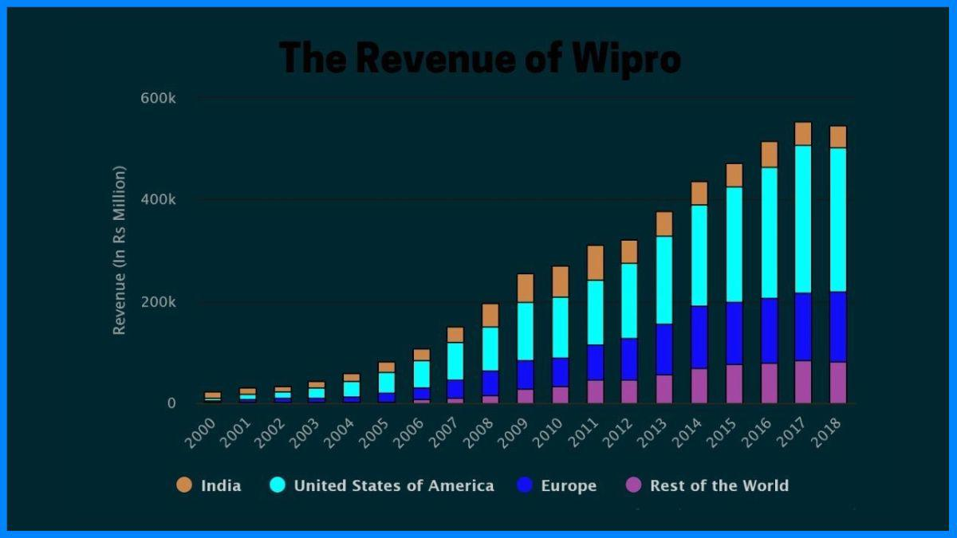
Analysis of Wipro:

Slide 33
Instagram Account Link:
https://instagram.com/wiproproducts?igshid=OGQ5ZDc2ODk2ZA==
Instagram Story Link:
https://www.instagram.com/s/aGlnaGxpZ2h0OjE4Mzg4ODQxMzQ0MDQwODg3?story_media_id=3212094858886570187_62093783345&igshid=OGQ5ZDc2ODk2ZA==

Slide 34
thank you...!

